Slide 1

Problem Set #1

Slide 2
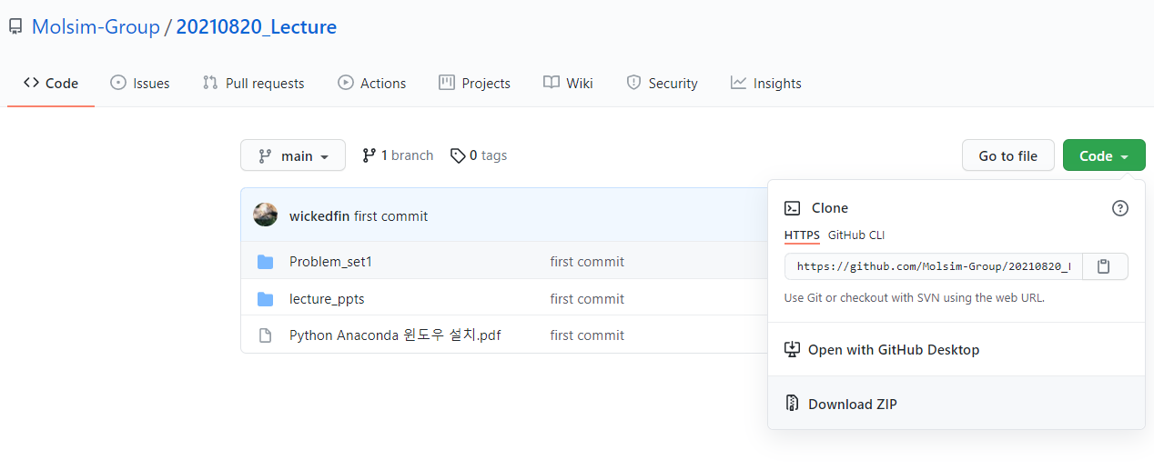
Problem Set #1
Download Lecture materials from below link
https://github.com/Molsim-Group/20210820_Lecture

Slide 3
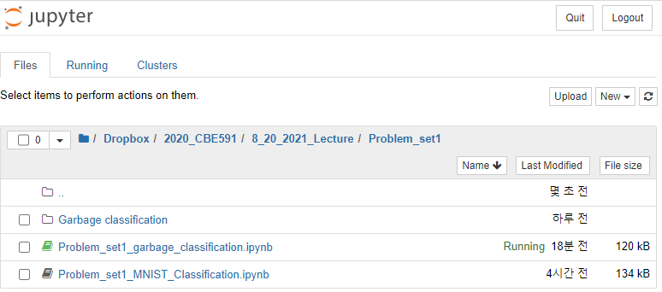
Problem Set #1
In this homework, we will go through some of the sample exercises from Lecture 2 to ensure that you can follow along the MNIST problem.
Details are written in Lecture 2 so you can look at them.
At [Problem_set1] folder, empty notebook file is prepared and you can start your exercise there.
“Click”

Slide 4
Problem Set #1
Part (a): from Slide 12, draw the image that you see upon executing the Python commands.
Part (b): from Slide 22, see how the precision and the recall scores that correspond to changing the threshold to -2000, 2000, and 4000.
Part (c): from Slide 24, draw the confusion matrix image for the multiclass classification.

Slide 5
Problem Set #1
Part (d): we will do classification with different dataset other than MNIST.
In the folder [Problem_Set1], there is a template notebook file prepared.
Launch the prepared [.ipynb] file to start your exercise.
“Click”

Slide 6
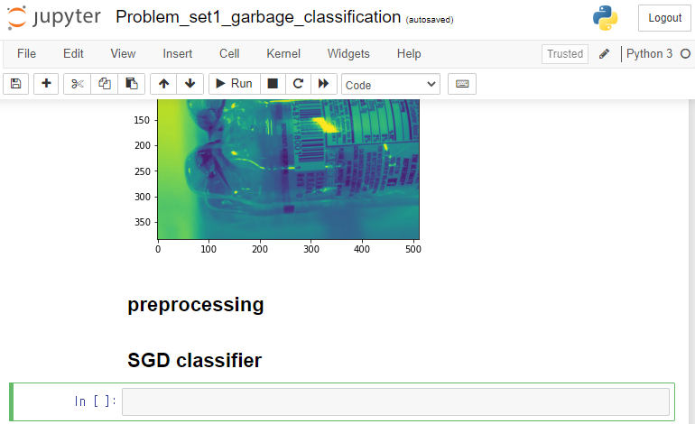
Problem Set #1
Execute the cells already written in the script and you can start from “SGD classifier” section.
Data and labels are stored in variable “X_train, y_train, X_test, y_test”
“This is where you should start

Slide 7
Problem Set #1
Conduct multiclass classification with the data given.
Use SGD classifier, set randomstate as 42
Draw confusion matrix image for “test dataset”, not “train dataset”
Result will not be looking that great but do not worry.
We will later see how it could be improved through utilizing deep learning.

